Slide 1
Achievement of recycling targets from the view of a collecting and recovery system in Austria;
Rogasaka Slatina, 13. Oct. 2016 Wilhelm Kleer

Slide 2
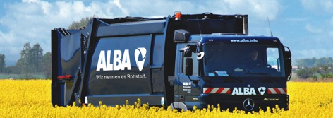
From waste disposal to the supply of raw materials.
Services
Waste and Metals
One of the leading recycling and environmental service providers, and raw material suppliers worldwide
In total over 8000 employees in Germany, Europe and Asia
Annual turnover volumes of around 2.5 billion Euro
Notes:
With its two brands – ALBA and Interseroh – ALBA Group operates within Germany, Europe, the U.S. and Asia. With an annual turnover of approx. 2.6 billion Euros (2013) and more than 8,000 employees* ALBA Group is one of the leading recycling and environmental services companies as well as raw material providers worldwide.
* headcount / minority shareholdings included

Slide 3
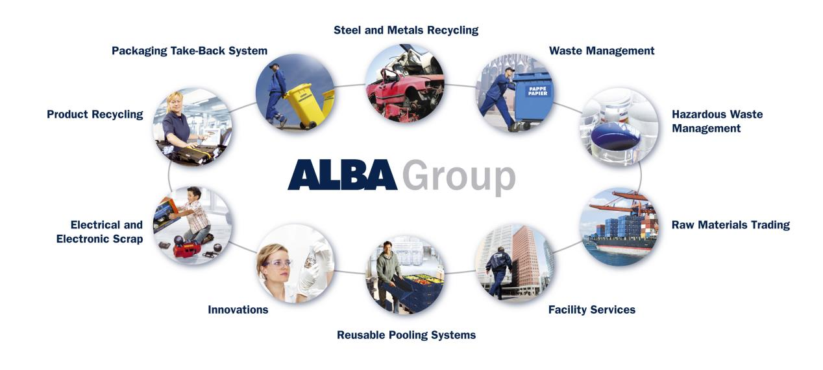
Many services from a single source.
Our mission statement:
material recycling instead of energy recovery
closed substance cycle from one source
secondary raw materials for all main substance streams

Slide 4
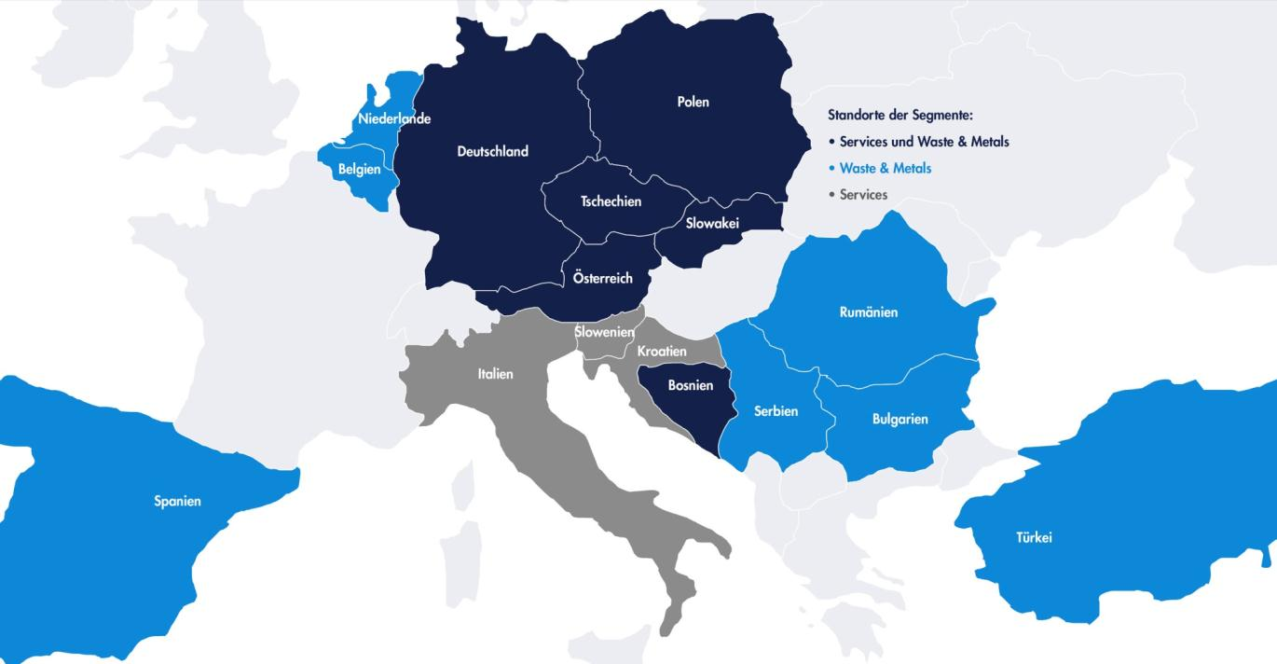
Transnational Know How. ALBA Group locations in Europa.

Slide 5
Waste management services.
Operator of collecting and recovery systems
Packaging
Electrical and electronical equipment
Batteries
EEE authorised representative
Waste management
Organising the waste management for
Production sites, car repair shops, central ware houses & branches ..
Consultancy service
Support / assistance to generate the monthly, quarterly or yearly report to the collecting and recovery system

Slide 6
Collection and Recovery Scheme für WEEE
Regulated with
WEEE Directive
Waste Management Act
WEEE Ordinance
Permission from the competent authortity

Slide 7
Targets for WEEE Collection and Recovery Schemes
Separate collection
Until end of 2015: 4kg/Inhabitant and year or > average from the three preceding years
From 2016: > 45% of the average weight of EEE placed on the market in the three preceding years
From 2019: > 65% of the average weight of EEE placed on the market in the three preceding years or > 85% of generated WEEE
Recovery / Recycling
From 15.08.2015:
> 70%– 85% recovery
> 50%– 80% prepared for re-use and recycling

Slide 8
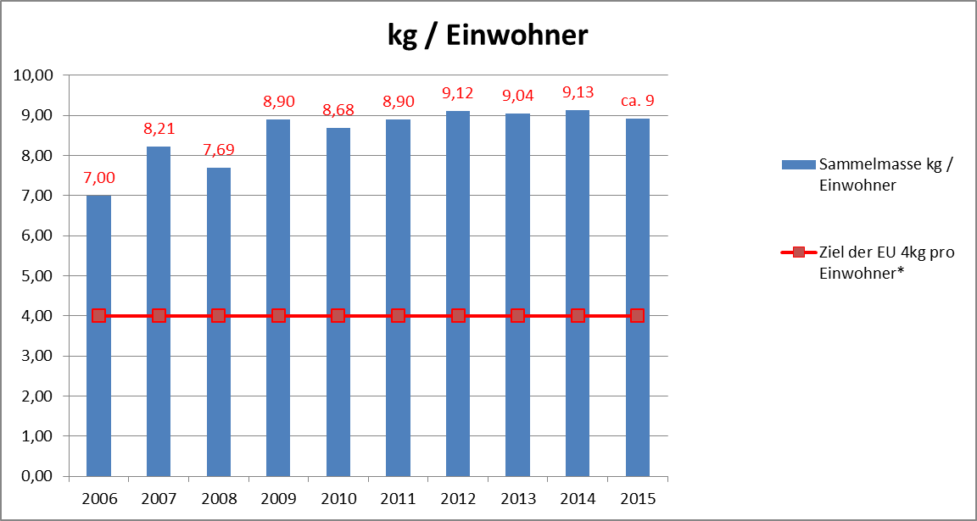
Target performance comparison; collection quote
Until 2015: > 4 kg / inhabitant and year
Source: EAK

Slide 9
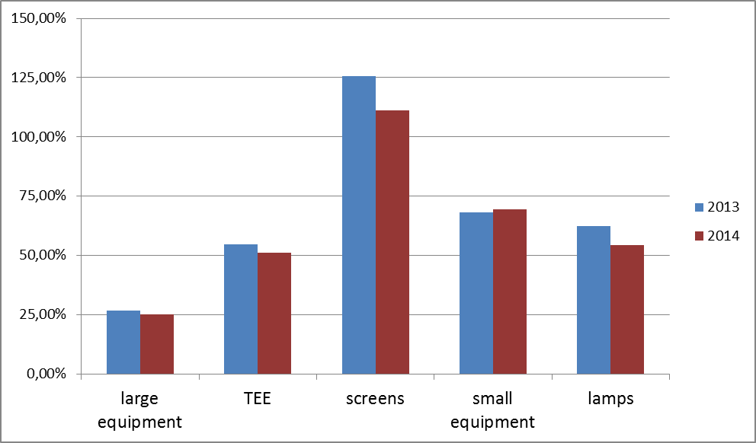
Collection quotes per category

Slide 10
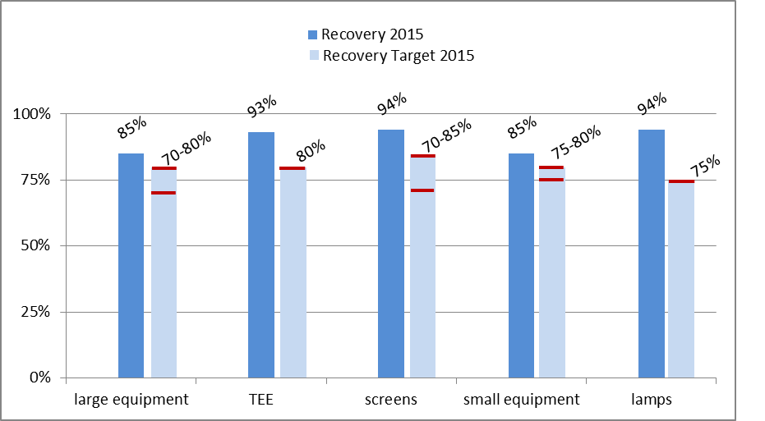
Target performance comparison; recovery

Slide 11
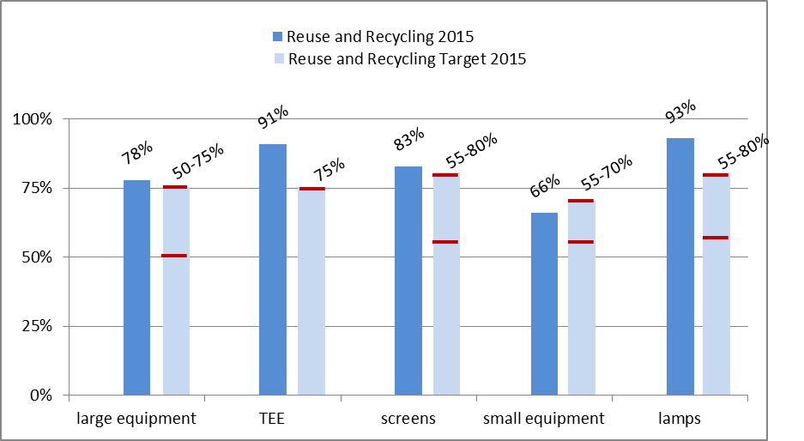
Target performance comparison; reuse and recycle

Slide 12
„Backbone“ for the collection
2.100 Municipal, puplic collection sites
150 Regional collection sites (Waste management companies)
Free of charge take back on a 1 : 1 basis (distributor with shops > 150 m²)
Exception for smaller shops
No obligation for a 0 : 1 take back for small WEEE (< 25 cm) by distributors with shops > 400 m²
Establishing of a clearing house

Slide 13
Responsibilities of the clearinghouse
Calculation of the costs of public collection sites
Full equiped
Partly equiped
Organising the take over from the collection sites
Negotiation of costs for the information of the enduser
Preparation of a concept to inform the enduser
Working group with representatives
Ministry of environment
Association of Cities/Towns and Municipilities
Federal Economic Chamber and Represantation of employees
Collecting and Recovery schemes
Clearinghouse

Slide 14
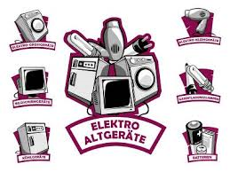
Information of enduser (1)
Information for collection sites
Manual / Guide
Categories, take over, apply for a pick up …
Standardized Pictograms
2 to 3 Newsletters per year, adressed to the waste consultants and municipal collection sites
All kind of information concerning WEEE, information about changes

Slide 15
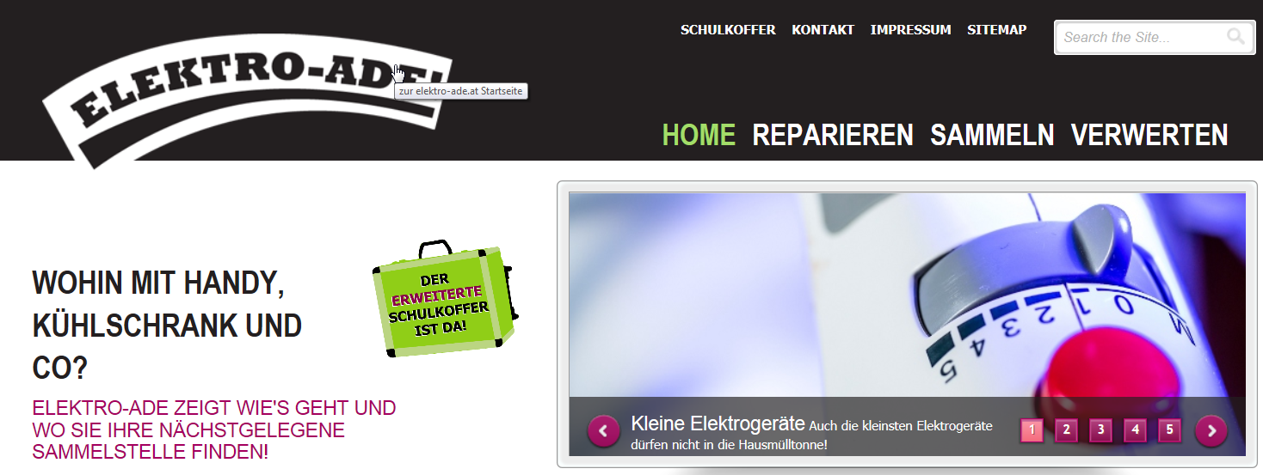
Information of enduser (2)
Workshops for waste consultants (ca. 100)
Website „elektro-ade.at“ with information about repair, collection, recycling and collection site finder
Press release
2 to 3 releases per year

Slide 16
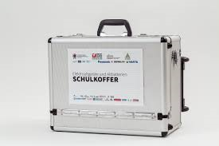
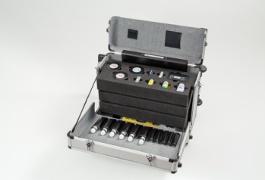
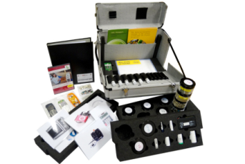
Information of endusers (3)
WEEE-“Schoolbag“ for waste consultants
Modular to adress several age groups
Target group manly between 8 and 14 years
Workshops and lesson at schools
Incl. School-DVD

Slide 17
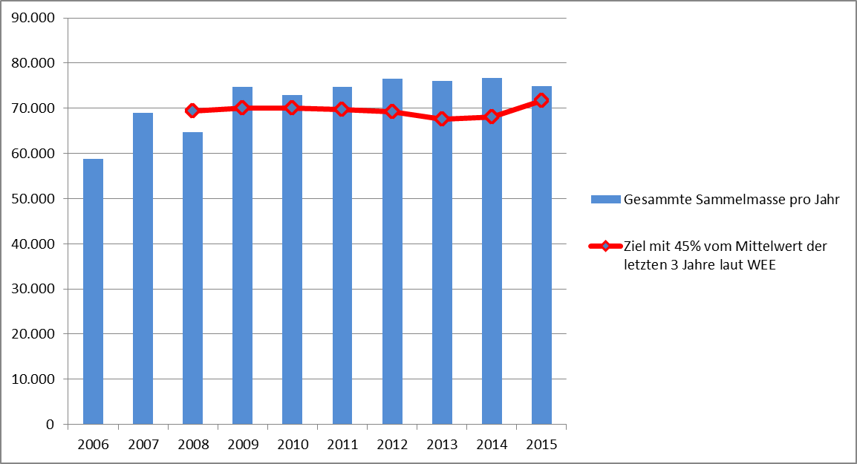
Target performance comparison; collection quote
From 2016: > 45% of the average weight of EEE placed on the market in the three preceding years
Source: EAK

Slide 18
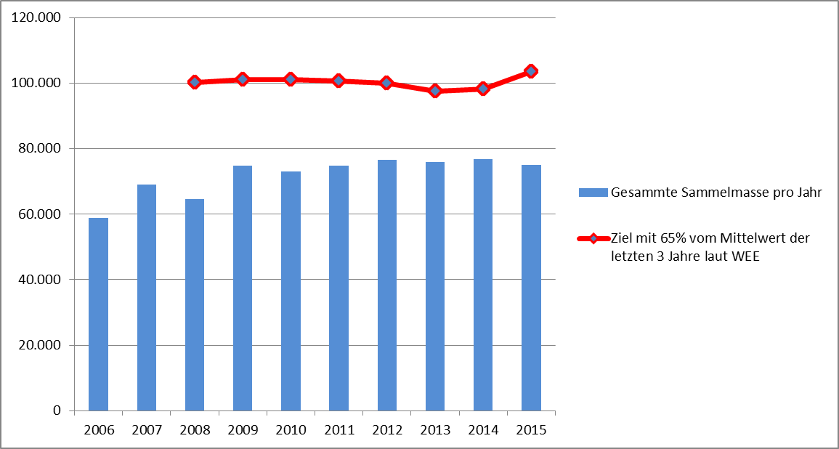
Target performance comparison; collection quote
From 2019: > 65% of the average weight of EEE placed on the market in the three preceding years
Source: EAK

Slide 19
Challenge for the future (1)
Calculation of the market amount
Different calculation methods
Each item
Average weight for EEE Groups
Calculation of the full amount of collected WEEE
Waste managemt- and municipality collection sites allowed to treat WEEE on ist own
Revenues for Large and Small equipment
Costs for TEE, Screens and lamps
It is not clear if the whole amount of LE and SE is reported to the register

Slide 20
Challenge for the future (2)
Reducing the illegal transport
Public relation activities for the prevention of illegal transport and exporting valuable resources
- Enduser, municipal waste sites and waste consultants
- Waste management companies

Slide 21
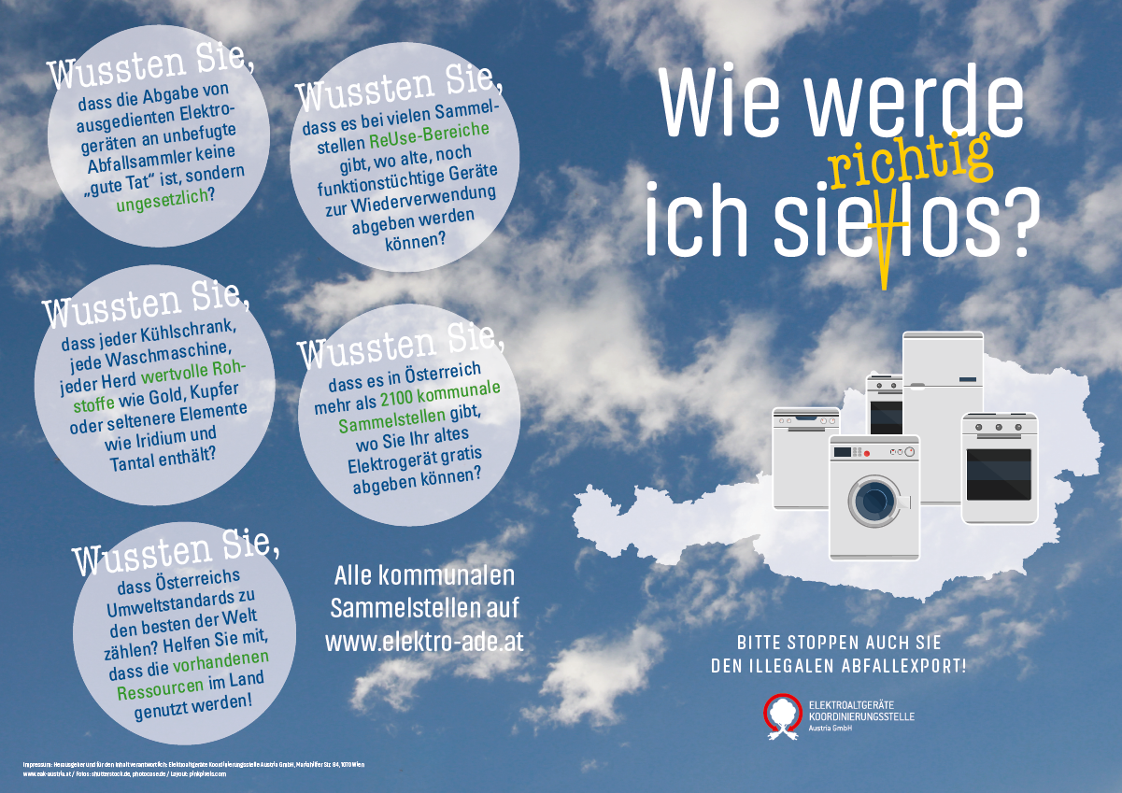
Reducing the illegal transport
How to get rid of them (properly)
Did you know, that giving used EEE to unauthorized waste collectors is not a good deed but illegal
Did you know, that each Refrig., WM, stove contains valuable resources
……. help that excisting recourses used nationally

Slide 22
Austrian raw materials are not garbage

Slide 23
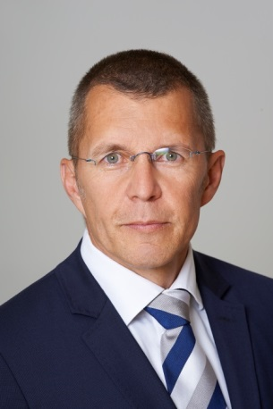
Your personal contact.
Name: Wilhelm Kleer
Tel.: +43 1 7142005 - 5100
Fax: +43 1 7142005 - 9900
Mobile: +43 664 3968147
E-Mail: wilhelm.kleer@interseroh.com
INTERSEROH Austria GmbH
Ungargasse 33
1030 Wien

